Slide 1

CENSUS
Aishwarya, Bryce, Dani, Diamond

Slide 2

Introduction
Employees of United States Census Bureau:
Utilizing our lecture program in high schools & universities around the nation
Showing students old census data to show correlations between certain factors (Age, Income, Weekly Working Hours, etc.)
Hoping to encourage students to pursue higher education

Slide 3
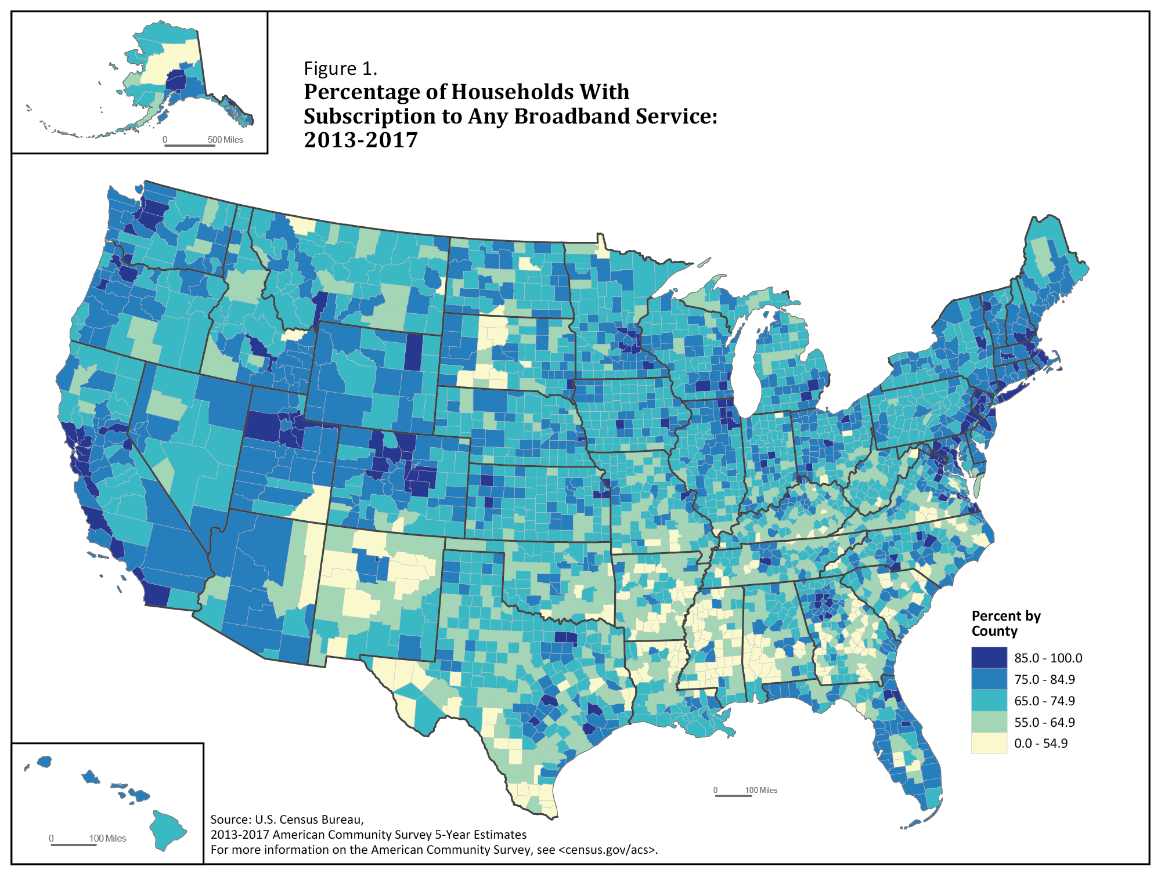
Background on Data
Total Number of Records – 45,223
Age: 17 – 90 (continuous)
Work Class: Federal-gov, Local-gov, Private, Self-emp-inc, Self-emp-not-inc, State-gov, Without-Pay
Education Level: 10th, 11th, 12th, 1st-4th, 5th-6th, 7th-8th, 9th, Assoc-academic, Assoc-voc, Bachelors, Doctorate, HS-grad, Masters, Preschool, Some-college
Education Number: 1, 2, 3, 4, 5, 6, 7, 8, 9, 10, 11, 12, 13, 14, 15, 16 (continuous)
Marital Status: Divorced, Married-AF-spouse, Married-civ-spouse, Married-spouse-absent, Never-married, Separated, Widowed
Occupation: Adm-clerical, Armed-Forces, Craft-repair, Exec-managerial, Farming-fishing, Handlers-cleaners, Machine-op-inspect, Other-service, Private-house-serv, Prof-specialty, Protective-serv, Sales, Tech-support, Transport-moving
Relationship: Husband, Not-in-family, Other-relative, Own-child, Unmarried, Wife
Race: Amer-Indian-Eskimo, Asian-Pac-Islander, Black, Other, White
Sex: Male, Female
Capital Gain: Continuous
Capital Loss: Continuous
Hours Per Week: Continuous
Native Country: Cambodia, Canada, China, Columbia, Cuba, Dominican-Republic, Ecuador, El-Salvador, England, France, Germany, Greece, Guatemala, Haiti, Holland-Netherlands, Honduras, Hong, Hungary, India, Iran, Ireland, Italy, Jamaica, Japan, Laos, Mexico, Nicaragua, Outlying-US (Guam-USVI-etc), Peru, Philippines, Poland, Portugal, Puerto-Rico, Scotland, South, Taiwan, Thailand, Trinidad and Tobago, United-States, Vietnam, Yugoslavia
Income: <=50K, >50K

Slide 4
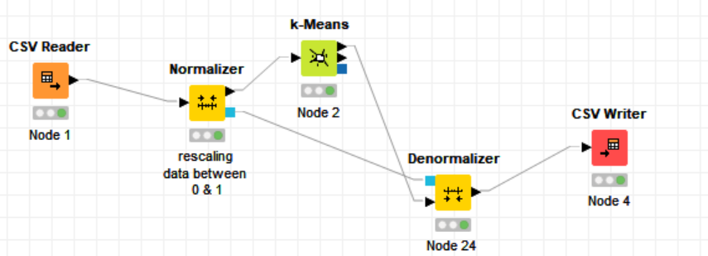
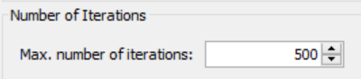
K-Means Clustering
Variables:
Clustered by Age
Number of Clusters: 5
Normalized options:
Age
Education-num
Capital-gain
Capital-loss
Hours-per-week
Notes:
"This is definatly unsupervised learning... our team sat here and went through about every option Tableau had to vaguely get some clusters"

Slide 5
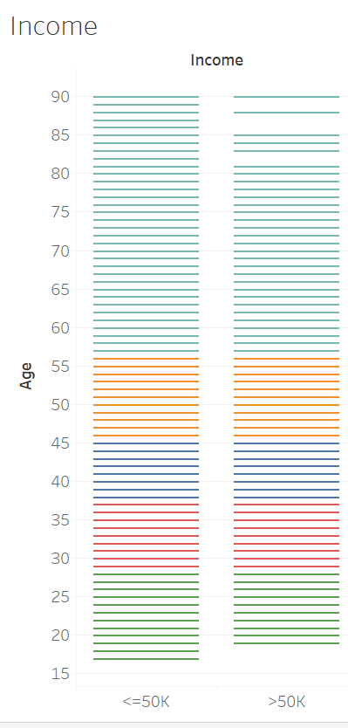
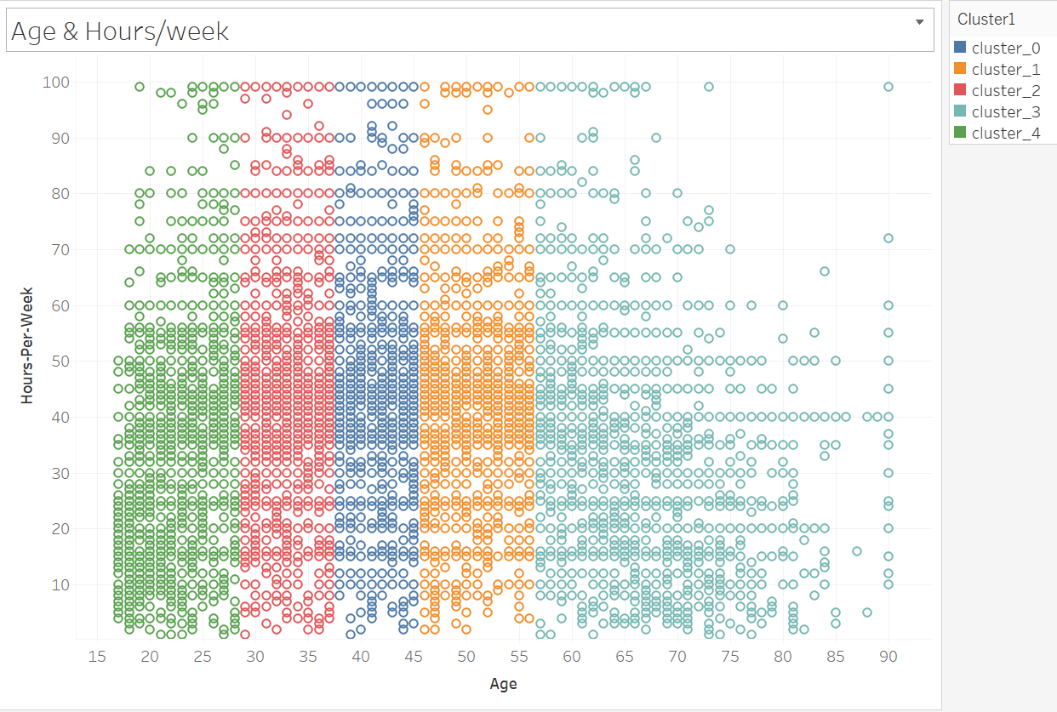
Age in Relation to Hours/Week and Income
Notes:
Dense population from 25-60
Do things over time right, easier to remember (almost similar to different generations)

Slide 6
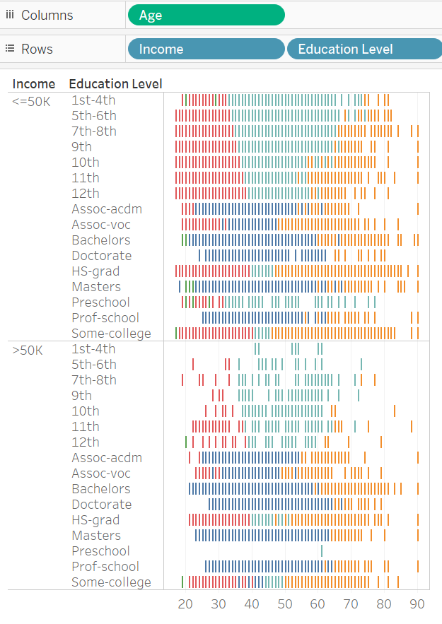
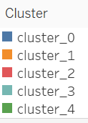
Age in Relation to Income and Education Level
Variables:
Number of Clusters: 5
Clustered and normalized by:
Age
Education-num
Capital-gain
Capital-loss
Hours-per-week

Slide 7
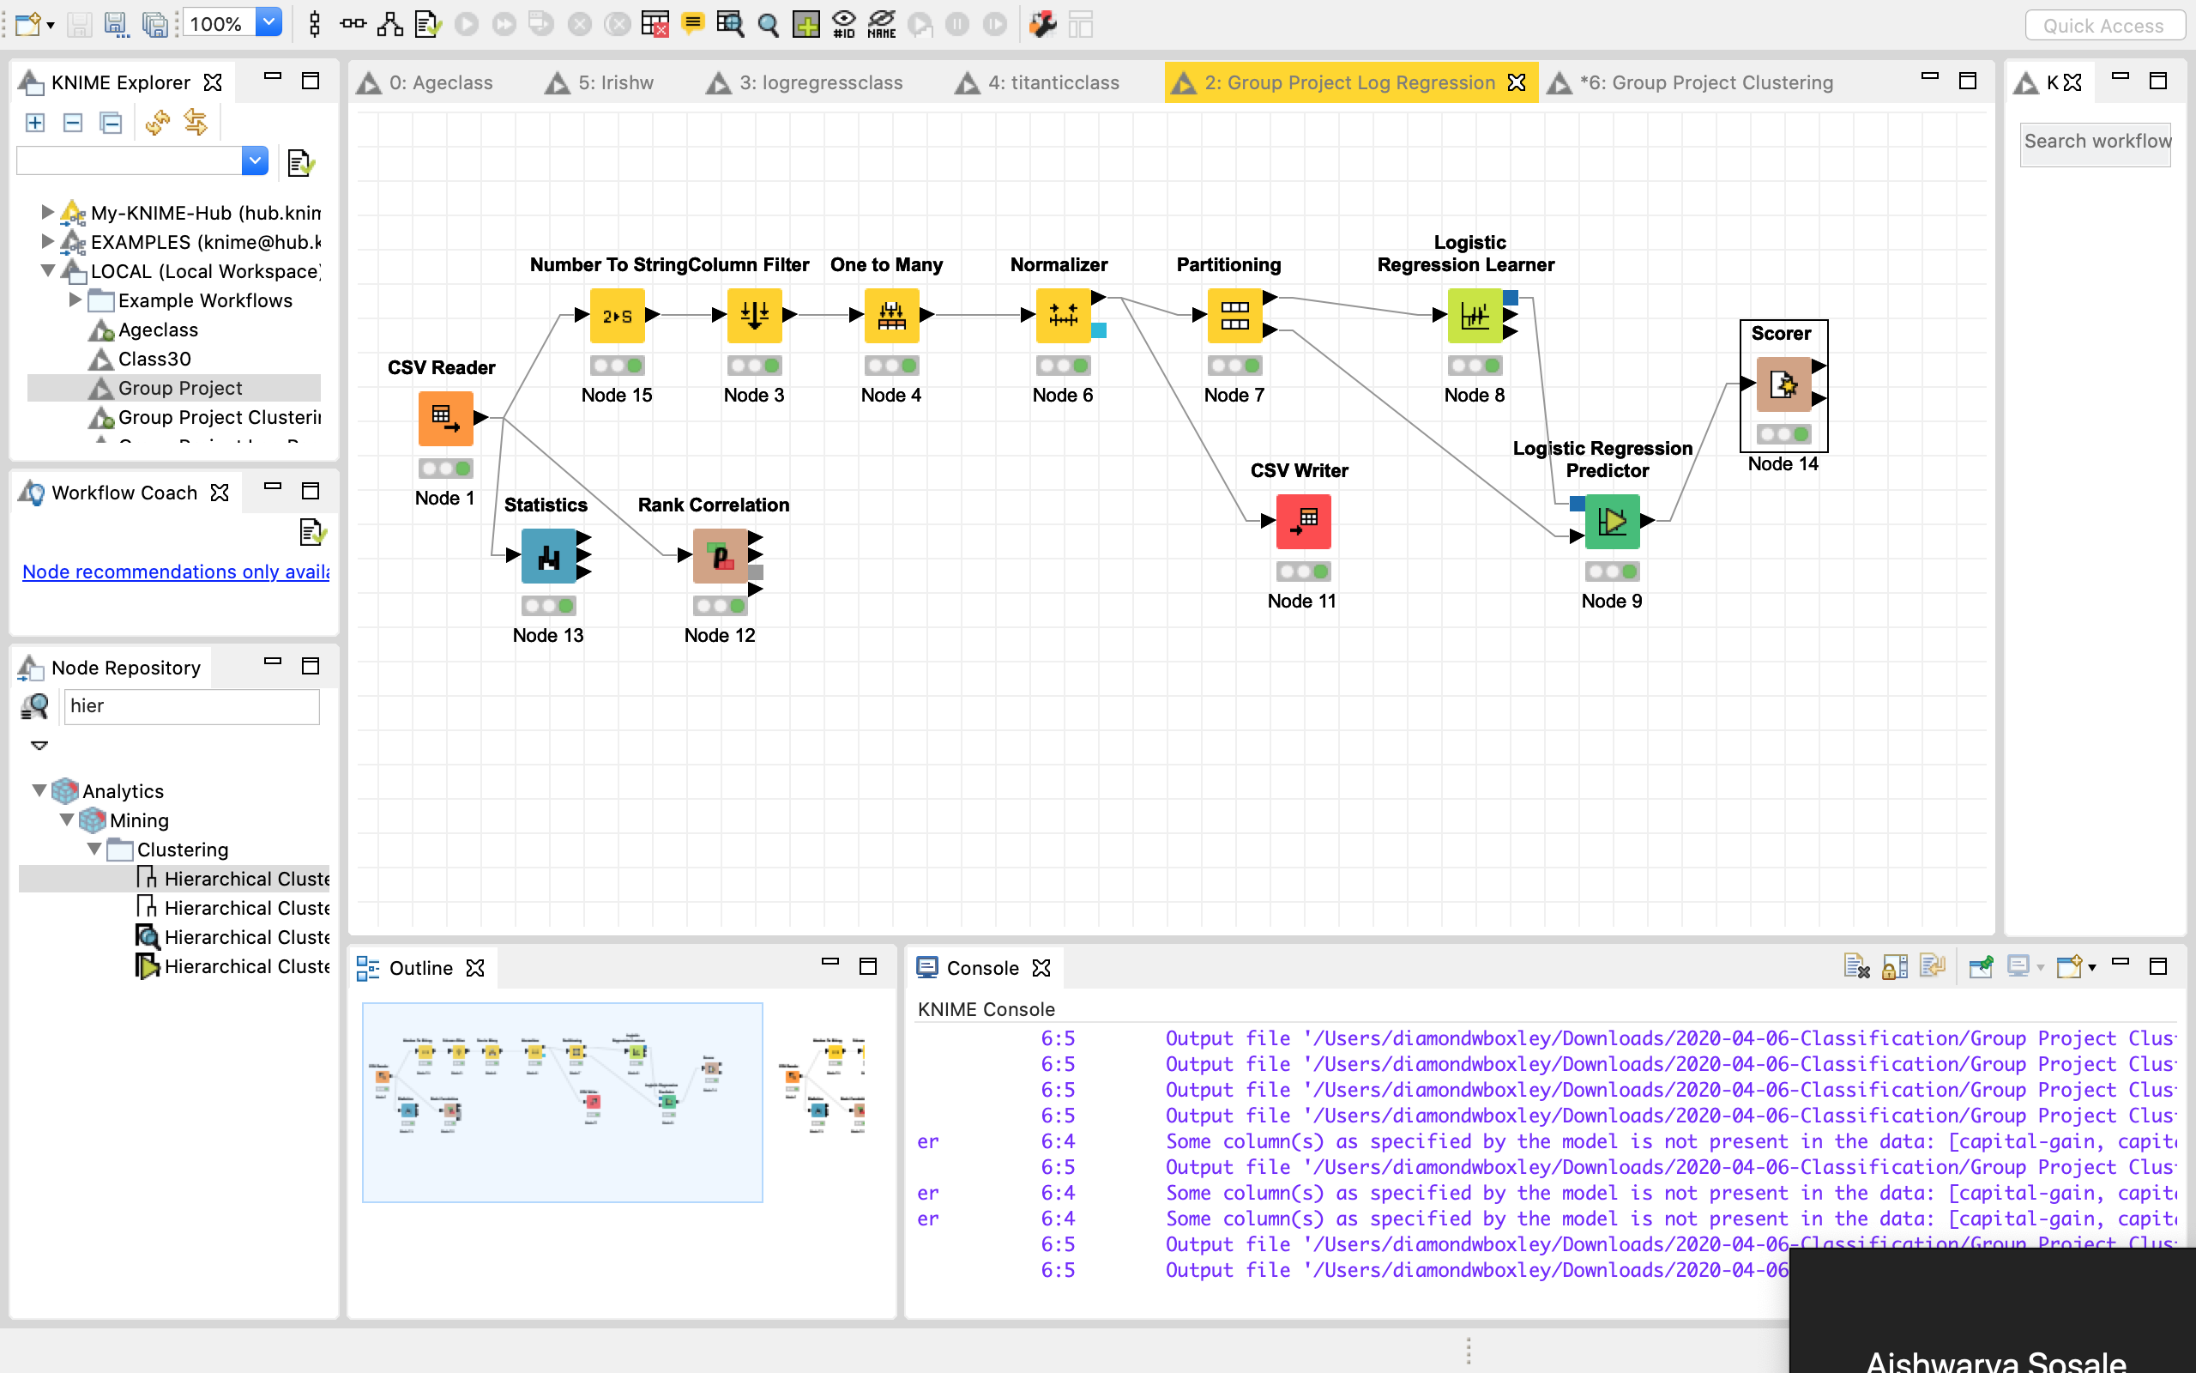
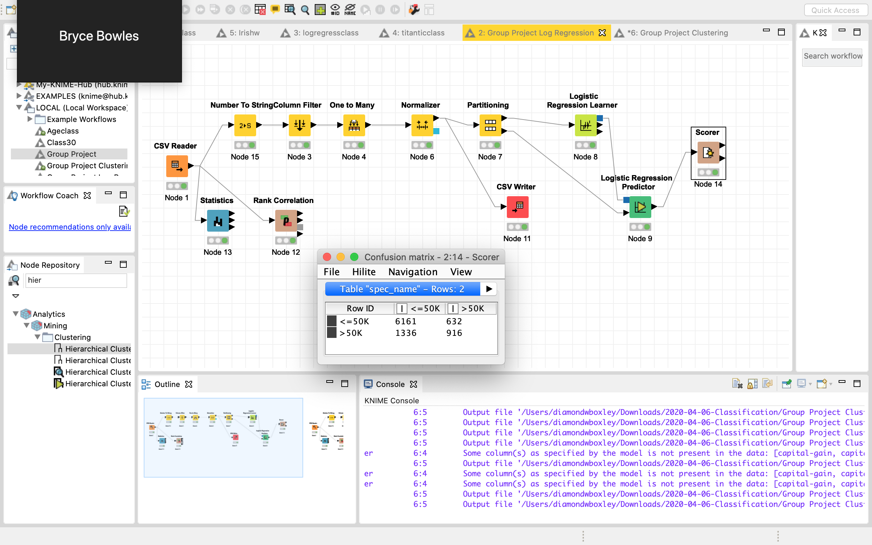
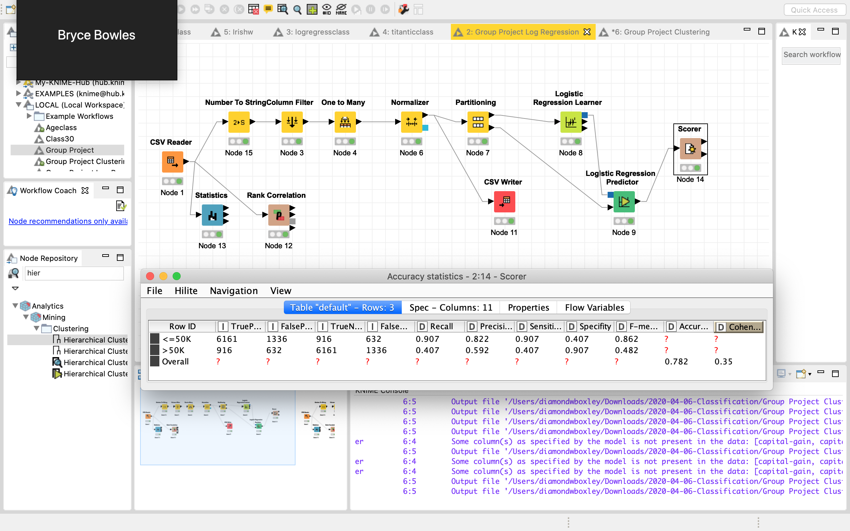
Logistic Regression
Model:
Variables:
Income
Education level
Race
Sex

Slide 8

Insights
Most citizens work under 60 hours.
People from ages 17-55 tend to work more than 60 hours more than adults over ages 55.
Individuals over 55 make up a large portion of those making over $50,000.
People 27 and younger make up a small portion of those making over $50,000.
About the same percentage of citizens, 27-55, who make over $50,000 made under $50,000.
More 17-27 year olds made less than $50,000, then they did over $50,000

Slide 9


Conclusion
The data supports the conclusion that the more work experience in a field an individual collects the more the likelihood that that individual will advance in their career and ultimately start obtaining an income of >50K.
We encourage individuals to seek out higher education so that they advance faster in their careers and overcome that barrier to a higher pay scale faster/earlier in their life.

Slide 10
Feedback on Presentation
Slide 6 was great, but the insights don’t reflect our charts.
Next time: make all charts/graphs then make insights on what we learn from those charts

